Slide 1


JIYAAN INSTITUTE
Day 9
Exception Handling
in Python
Handle errors gracefully without stopping your program

Slide 2

What Are Exceptions?
Exceptions are events that disrupt the normal flow of a program. They occur when an error is encountered during execution.
ZeroDivisionError
FileNotFoundError
Raised when dividing any number by zero
Raised when a file or directory is not found
ValueError
TypeError / NameError
Raised when an invalid value is passed to a function
Invalid type operations or undefined variables
JIYAAN INSTITUTE
Day 9 — Exception Handling in Python

Slide 3


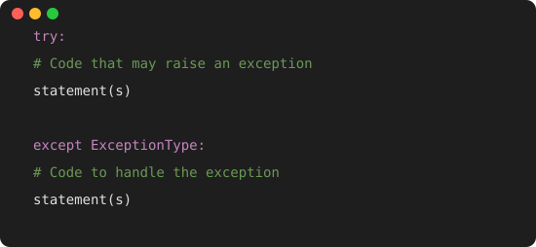
Basic try-except Syntax
try block
Put the risky code that might fail here
except block
Catches specific errors and handles them
as e
Stores the error message in variable e for logging
💡 Tip: Always catch specific exceptions (e.g., NameError) rather than using a bare except: block
JIYAAN INSTITUTE
Day 9 — Exception Handling in Python

Slide 4


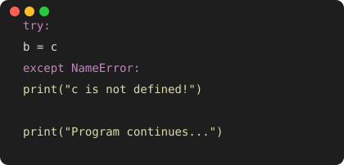
Example: Handling NameError
❌ Without Exception Handling
✅ With Exception Handling
🔴 Program CRASHES with NameError
🟢 Program continues execution normally
How it works: Python runs the try block → error occurs → jumps to matching except block → handles it → execution continues after the block.
JIYAAN INSTITUTE
Day 9 — Exception Handling in Python

Slide 5

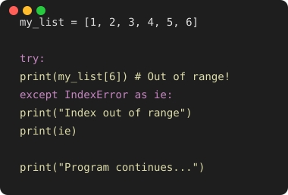
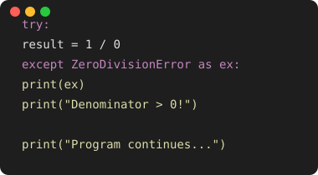
More Exception Examples
IndexError
ZeroDivisionError
JIYAAN INSTITUTE
Day 9 — Exception Handling in Python

Slide 6

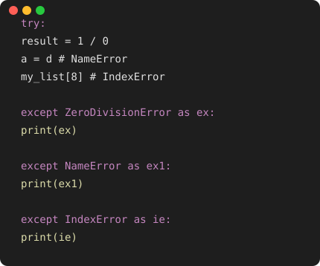
Multiple Exception Handling
You can handle different exception types with multiple except blocks, or use a single generic Exception to catch all.
Order Matters
Python checks each except block top to bottom and executes the first match.
First Error Wins
Only the first exception is caught. Code stops at the error line inside try.
Generic Catch-All
Use except Exception as ex: to catch any exception not handled above.
JIYAAN INSTITUTE
Day 9 — Exception Handling in Python

Slide 7

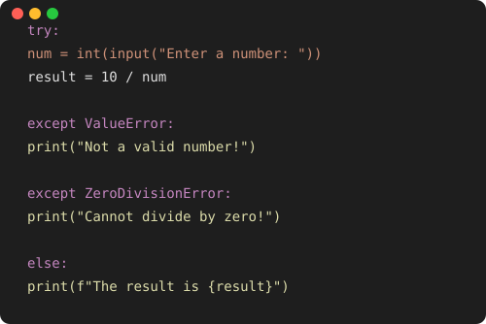
try — except — else
The else block runs ONLY when no exception occurs in the try block.
try
Risky code executes
↓
except
Runs if error occurs
↓
else
Runs ONLY if no error
JIYAAN INSTITUTE
Day 9 — Exception Handling in Python

Slide 8

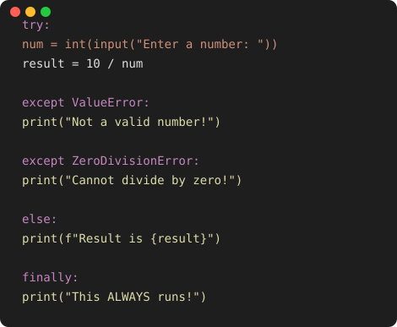
The Complete Structure: try-except-else-finally
try
Always runs first
except
Only if error occurs
else
Only if NO error
finally
⚠️ finally is perfect for cleanup: closing files, database connections, releasing resources — it runs no matter what!
ALWAYS runs
JIYAAN INSTITUTE
Day 9 — Exception Handling in Python

Slide 9

Summary Table
Block | When it Runs | Purpose | Example Use Case
try | Always runs first | Holds code that might raise an exception | User input, file operations, network calls
except | Only if exception occurs in try | Catch and handle specific or general errors | Handle ValueError, ZeroDivisionError
else | Only if NO exception occurs | Run code when everything succeeds | Print results, continue normal flow
finally | ALWAYS runs, no matter what | Cleanup like closing files/resources | Close DB, print final message
JIYAAN INSTITUTE
Day 9 — Exception Handling in Python

Slide 10

Key Takeaways
1
try → Put risky code that might cause errors
2
except → Handle specific or unexpected errors gracefully
3
else → Execute code only when try succeeds without errors
4
finally → Always runs — ideal for cleanup operations
5
Always catch specific exceptions before using generic Exception
This structure keeps your code robust, prevents crashes, and ensures important cleanup actions always happen.
JIYAAN INSTITUTE

